Slide 1
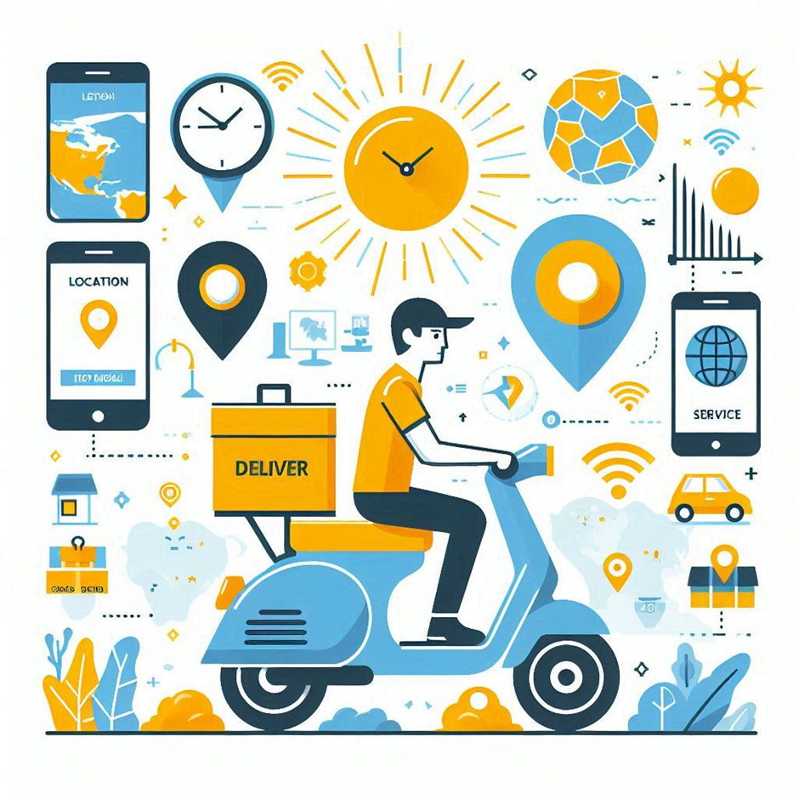
SwiftSend
-A Crowd Sourced Delivery
Team Name: EUREKA

Slide 2

PROBLEM STATEMENT
Traditional delivery systems struggle with high costs, inefficiencies, and a large environmental footprint. Imagine a world where everyday travelers can help deliver packages on their way, saving money and reducing emissions. We propose a web application that connects these travelers with delivery opportunities, offering a fee for their service. This approach will make deliveries faster, cheaper, and greener, transforming how we think about logistics.

Slide 3
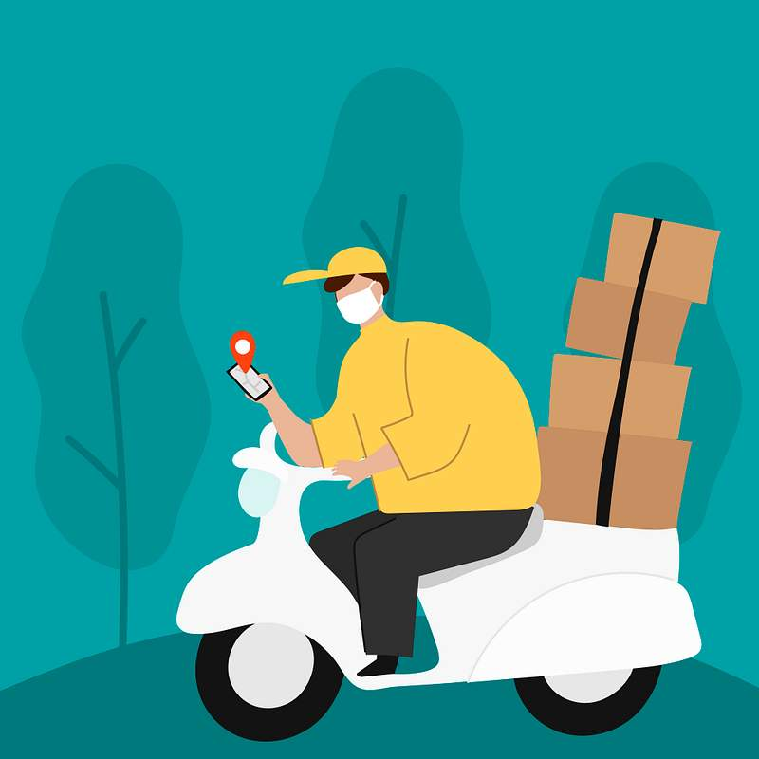
Proposed Solution
The web application facilitates public requests for product delivery and pickup points. Commuters traveling in the same direction can accept these requests. The application mediates between the salesman and customer, allowing the salesman to contact commuters to arrange pickup. The selected commuter receives delivery details, including customer information and address, and the customer can track the delivery progress.

Slide 4
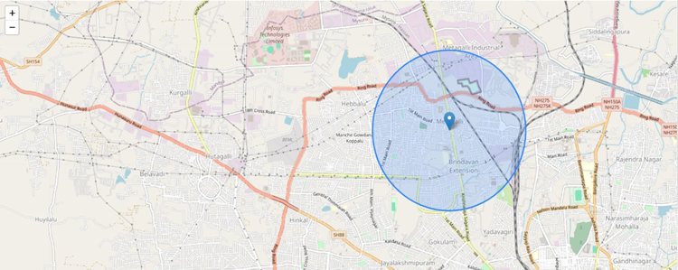
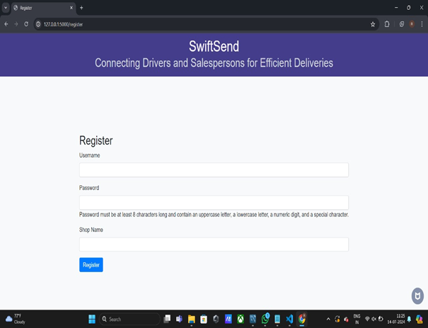
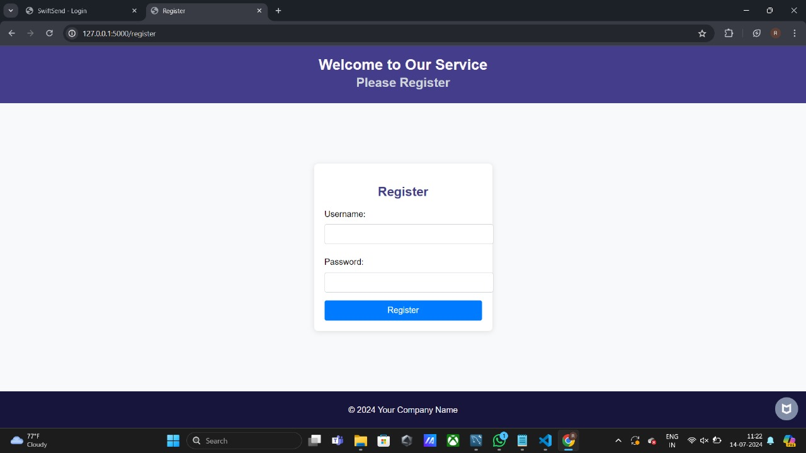
Implementation

Slide 5
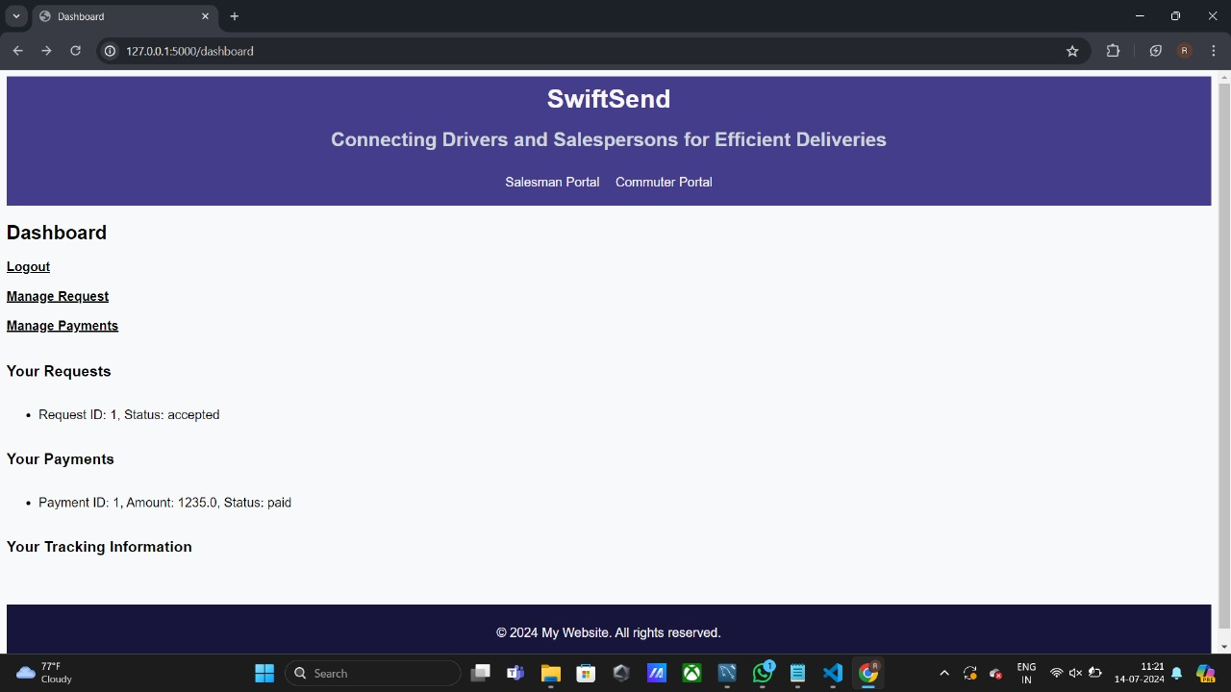
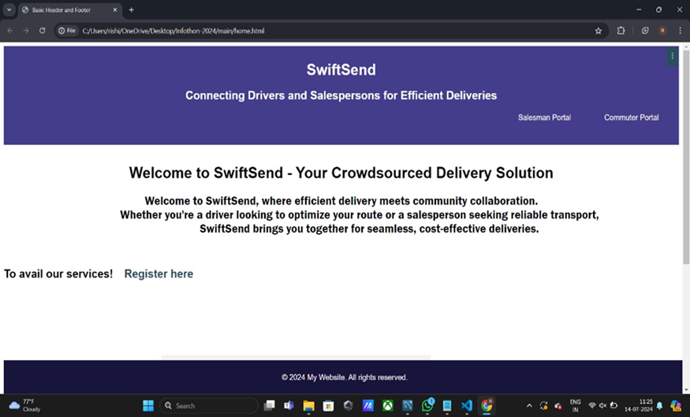

Slide 6


